Slide 1
CS 3186
NPDAs & Context-Free Languages
Section 7.2

Slide 2

Theorem:
Context-Free
Languages
(Grammars)
Languages
Accepted by
NPDAs
If L(G) is a context free language iff there exists a PDA M such that L(G)=L(M)

Slide 3
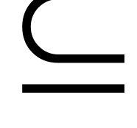



Proof - Step 1:
Context-Free
Languages
(Grammars)
Languages
Accepted by
NPDAs
Convert any context-free grammar
to a NPDA with:

Slide 4

Proof - Step 2:
Context-Free
Languages
(Grammars)
Languages
Accepted by
NPDAs
Convert any NPDA to a context-free
grammar with:

Slide 5
Converting
Context-Free Grammars to
NPDAs
Proof - step 1

Slide 6


Part 1: Converting CFG to NPDA
We will convert any context-free grammar
to an NPDA automaton
Such that:
Simulates leftmost derivations of

Slide 7

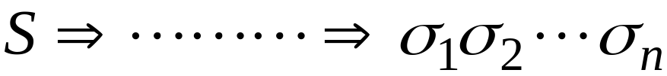





Leftmost derivation
string of terminals
Starting configuration
Stack
Input
S

Slide 8



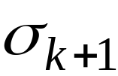


Leftmost derivation
Input
processed
Stack
contents
leftmost variable
Simulation of derivation
Stack
Input
The remaining input is derived by the rest of the stack contents

Slide 9
Leftmost derivation
string of terminals
Simulation of derivation
Stack
Input
end of input is reached

Slide 10


Constructing NPDA from grammar :
Algorithm :
• Let G = (V, T, S, P) be a grammar, Construct npda
M = ({q0, q1, q2 }, T, V T {z}, δ, q0, z, {q2 })
1. Define a transition rule to initialize the stack.
2. For every production rule in P of the form A->XY
define a transition rule: δ(q,λ,A)= (q,XY)
3. For every terminal a in T.
Define a transition rule: δ(q,a,a)=(q, λ)
4. Define transition rule to detect the end of processing.

Slide 11









Constructing NPDA from grammar :
For any production
For any terminal

Slide 12
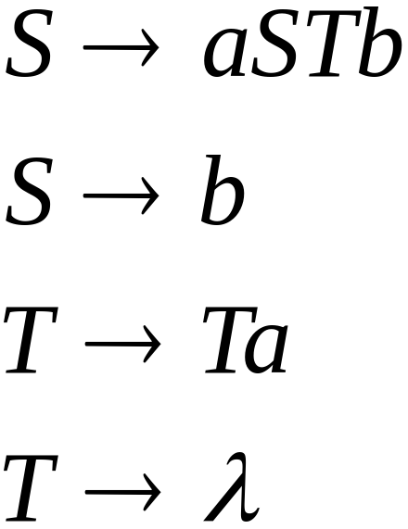
Example
Given a grammar:
What is the equivalent NPDA?

Slide 13

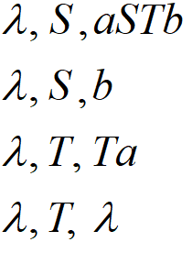
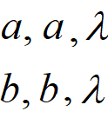


Example
Grammar
NPDA:

Slide 14
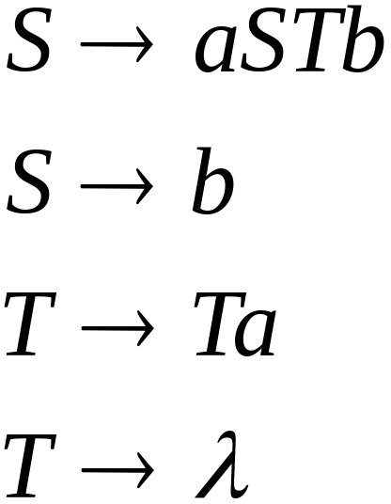
Example
Grammar:
A leftmost derivation:

Slide 15
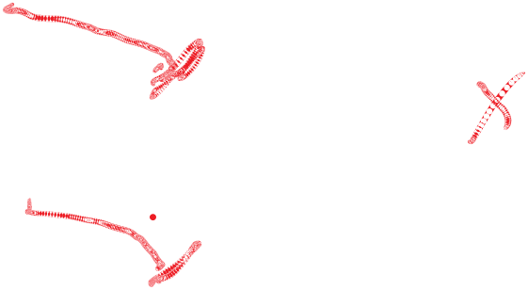







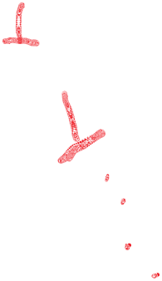
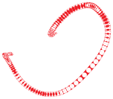


Example – Configuration Moves
(q0, abab, Z)
⊢ (q1, abab, SZ)
⊢ (q1, abab, aSTbZ) (q1, abab, bZ)
⊢ (q1,bab, STbZ)
⊢ (q1,bab, bTbZ) (q1, bab, aSTbTbZ)
⊢ (q1, ab, TbZ)
⊢ (q1,ab, TabZ) (q1, ab, bZ)
⊢ (q1,ab, abZ) (q1, ab, TaabZ) ⊢ (q1, ab, aabZ) ⊢ (q1, b, abz)
⊢ (q1,b, bZ) (q1,ab,TaTaabZ)
⊢ (q1, λ, Z)
⊢ (q2, λ, λ)

Slide 16
Example
The eleven steps processed by the npda is shown below
Step # | Processed Input | Stack content | Left Sentential derivation
1 |  | Z
2 |  | SZ | S
3 |  | aSTbZ | aSTb
4 | a | STbZ
5 | a | bTbZ | abTb
6 | ab | TbZ
7 | ab | TabZ | abTab
8 | ab | abZ | abab
9 | aba | bZ
10 | abab | Z
11 (Accept) | abab
Note that the processed input – stack content (ignoring the stack bottom marker “Z” ) mimics the left sentential derivation sequence.

Slide 17

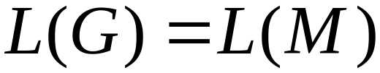
Part 1: Converting CFG to NPDA
By the construction process of the NPDA
Grammar generates string
if
NPDA accepts

Slide 18
Part 1: Converting CFG to NPDA
Therefore:
For any context-free grammar
there is a NPDA
that accepts the same language

Slide 19
Converting
NPDAs to
Context-Free Grammars
Proof - step 2

Slide 20
Part 2: Converting NPDA to CFG
Intuition:
The grammar simulates the NPDA
Basic idea: To construct a context-free grammar from an npda, reverse the
previous construction. i.e., construct a grammar to simulate npda moves.
This leads to a relatively complicated construction. (Skip for now)

Slide 21
Equivalence of NPDA and CFG
By the above two constructions,
(Part 1 and Part 2):
Context-Free
Languages
(Grammars)
Languages
Accepted by
NPDAs

Slide 22
Section 7.3 Summary
Deterministic Context-Free Grammars
Deterministic context-free languages are a subset of context free languages.
Many programming languages can be described by means of DCFLs which are accepted by DPDA
Thus deterministic context-free languages are important in the theory and design of compilers for programming languages.
The dpda essentially defines a parsing machine. Because it is deterministic, there is no backtracking involved. We can thus easily write a reasonably efficient computer program to implement the parser

Slide 23
(1) Do exercises #3, #7, #8
(For a string w (of length at least 4) generated by the grammar using leftmost derivations, show the corresponding moves in the NPDA – See the Example in the slides)
Homework 7.2
(2) Convert the following CFG to a PDA
E → E + T | T
T → T * F | F
F → (E) | a
For a string a * (a+a), give the leftmost derivation and the NPDA moves
(3) Convert the following CFG to a PDA
S → aAA
A → aS|bS|a
.For a string of length >=4, give the leftmost derivation and the NPDA
configurations

Slide 24
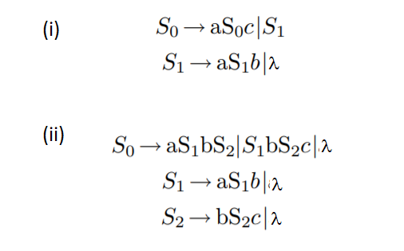
Homework 7.2
(4) Convert the following CFG to a PDA
.For a string of length >=4, give the leftmost derivation and the NPDA
configurations. Note that S₀, S₁, S₂ are the variables.

Slide 25
Homework 7.2
(5) Convert the following CFG to a PDA
.For a string of length >=4, give the leftmost derivation, derivation tree and the PDA configurations
S → aB | bA | λ
A → aS | bAA
B → bS | aBB

